Slide 1

Credit Card Customer Churn
By Chaitra Setty, Jacob Rhymes, Samuel Oh, Soumik Choudhuri

Slide 2

Problem Statement
Banks are disturbed with more and more customers leaving their credit card services. They would like to be able to predict when a customer is going to leave so they can provide them better service and hopefully sway the customer’s decision in the opposite direction.
In Summation: Predict and reduce churn.

Slide 3
Process Overview
Step 1
Step 2
Step 3
Step 4
Step 5
Cleaned the data
Exploratory analysis
Regression and classification models
Secondary analysis based on models
Business insights
Potential Drawbacks
Next Steps
Notes:
Update the icons

Slide 4

Characteristics of the Dataset
10,127 Customer Records
23 Features
Removed 2 features that added no value to our data set and converted categorical variables into numerical variables
16% Customers Attritted
Used SMOTE to balance the classification data
30% missing data
Removed 3,046 records with N/A values

Slide 5

Initial Exploratory Analysis

Slide 6
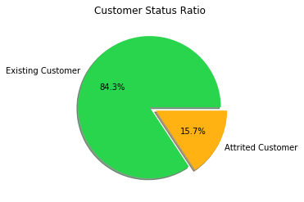
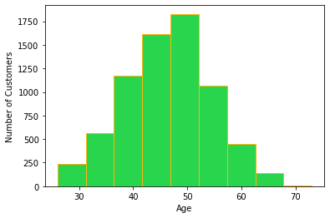
Initial Exploratory Analysis
Age

Slide 7
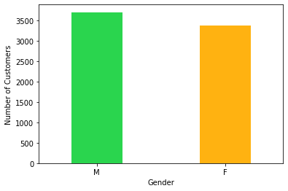
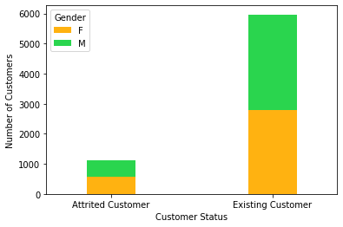
Initial Exploratory Analysis
Number of Customers
by Customer Status & Gender
Gender

Slide 8
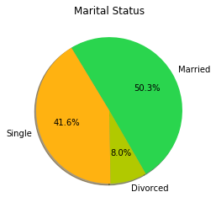
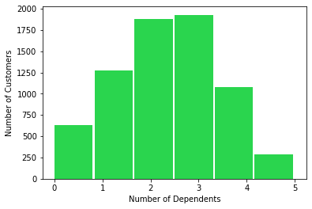
Initial Exploratory Analysis
Number of Customers
by Number of Dependents

Slide 9
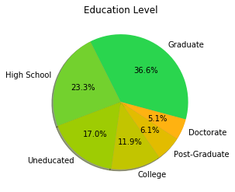
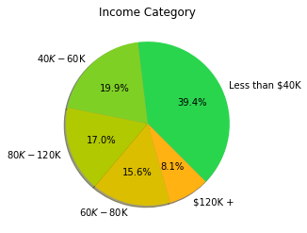
Initial Exploratory Analysis

Slide 10
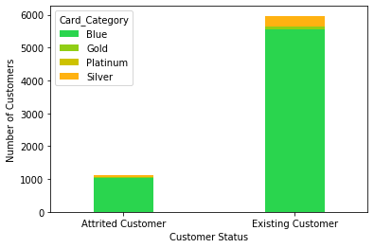
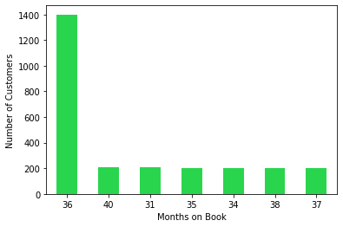
Initial Exploratory Analysis
Number of Customers
by Customer Status & Card Type
Number of Customers
by Months on Book

Slide 11
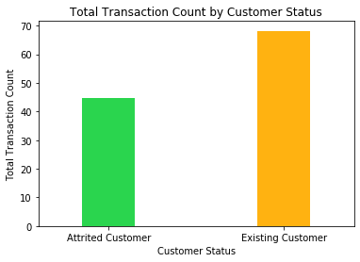
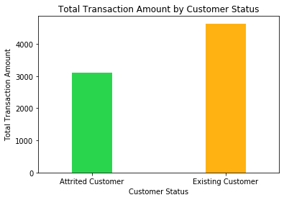
Initial Exploratory Analysis

Slide 12
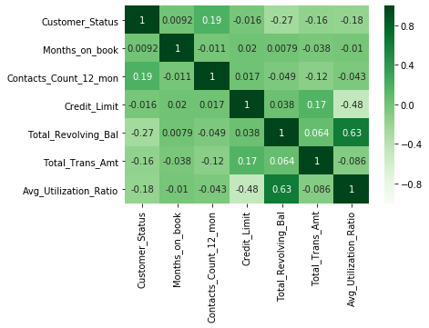
Initial Exploratory Analysis
Correlation Matrix

Slide 13

Classification Analysis 1:
Logistic Regression
01

Slide 14
Logistic Regression
Variables | +ve Coefficients
Contacts_Count_12_mon | 0.4533
Months_Inactive_12_mon | 0.3824
Dependent_count | 0.2154
C(Gender)[1] | 0.1066
C(Marital_Status)[T.Single] | 0.0989
Customer_Age | 0.0773
C(Education_Level)[T.6] | 0.0174
C(Education_Level)[T.4] | 0.0130
C(Education_Level)[T.3] | 0.0111
C(Card_Category)[T.2] | 0.0104
C(Education_Level)[T.5] | 0.0098
C(Income_Category)[T.120] | 0.0088
Avg_Utilization_Ratio | 0.0062
C(Card_Category)[T.3] | 0.0055
C(Income_Category)[T.40] | 0.0030
C(Card_Category)[T.4] | 0.0026
Total_Trans_Amt | 0.0003
Credit_Limit | 0.0000
Variables | -ve Coefficients
Total_Revolving_Bal | -0.0009
C(Education_Level)[T.2] | -0.0012
C(Income_Category)[T.80] | -0.0039
Total_Amt_Chng_Q4_Q1 | -0.0295
C(Income_Category)[T.60] | -0.0346
Months_on_book | -0.0538
C(Gender)[2] | -0.0564
C(Marital_Status)[T.Married] | -0.0574
Total_Ct_Chng_Q4_Q1 | -0.0911
Total_Trans_Ct | -0.0948
Total_Relationship_Count | -0.3107
*Categorical variables are converted to indicator variables

Slide 15
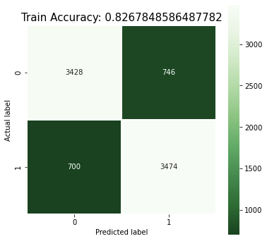
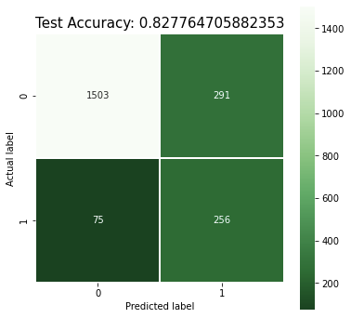
Logistic Regression
Confusion Matrix for Logistic Regression

Slide 16
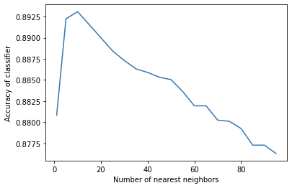
KNN Model
10 fold Cross Validation Performed
Optimal Nearest Neighbors: 10
Accuracy of score: 89.54%

Slide 17

Classification Analysis 2:
K Nearest Neighbours
02

Slide 18

Classification Analysis 3:
Tree based algorithms
03

Slide 19
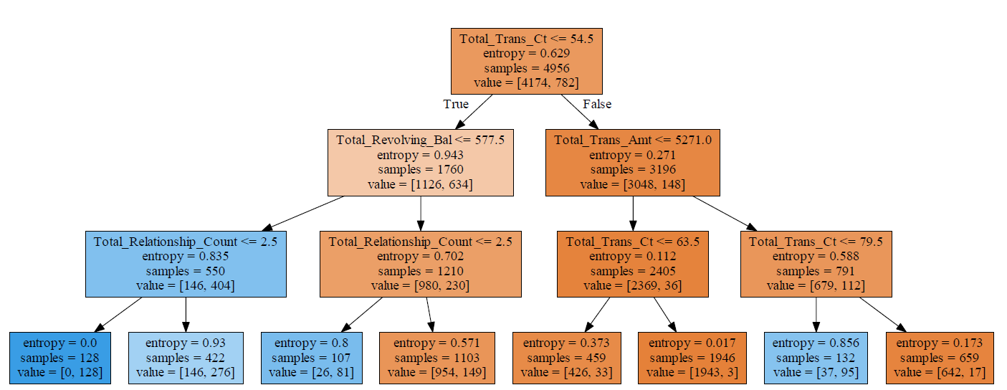
Decision Trees
Minimum Entropy used as splitting factor
Optimum Max depth =5 after 5-fold Cross Validation
Decision Tree with max_depth = 3

Slide 20
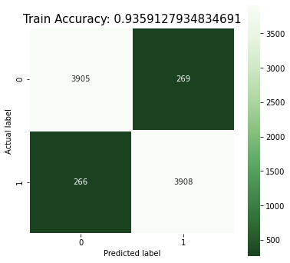
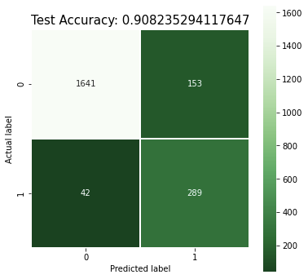
Decision Trees
Confusion Matrix for Decision Trees

Slide 21
Decision Trees
Random Forest, Variable Importance
Combination of multiple trees
n_estimators = 100
Top Variables | Importance
Total_Trans_Amt | 0.187
Total_Trans_Ct | 0.157
Total_Revolving_Bal | 0.110
Total_Ct_Chng_Q4_Q1 | 0.102
Avg_Utilization_Ratio | 0.068
Total_Relationship_Count | 0.066
Total_Amt_Chng_Q4_Q1 | 0.064
Credit_Limit | 0.044
Customer_Age | 0.036
Months_on_book | 0.029
Contacts_Count_12_mon | 0.026
Months_Inactive_12_mon | 0.026
Dependent_count | 0.016
C(Marital_Status)[T.Married] | 0.009

Slide 22

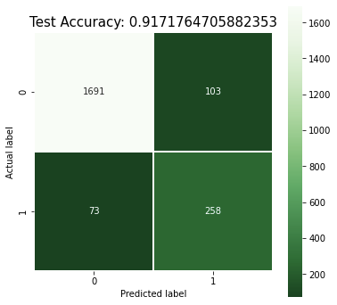
Decision Trees
Confusion Matrix for Random Forest

Slide 23

Secondary Exploratory Analysis
Based on regression model variable importance statistics

Slide 24
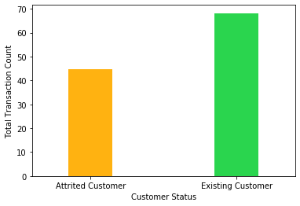
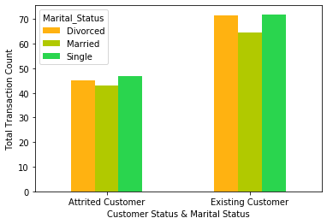
Secondary Exploratory Analysis
Total Transaction Count
Total Transaction Count and Attrition Rate
Total Transaction Count and Marital Status
Notes:
trying to find deviations between this association between utilization and attrition

Slide 25
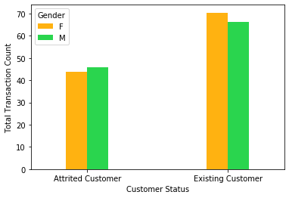
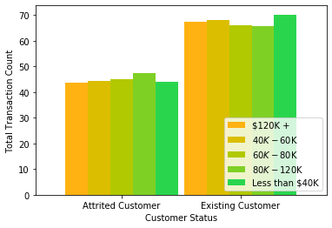
Secondary Exploratory Analysis
Total Transaction Count
Total Transaction Count and Gender
Total Transaction Count and Income Category

Slide 26
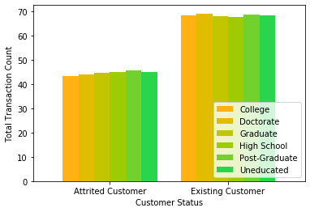
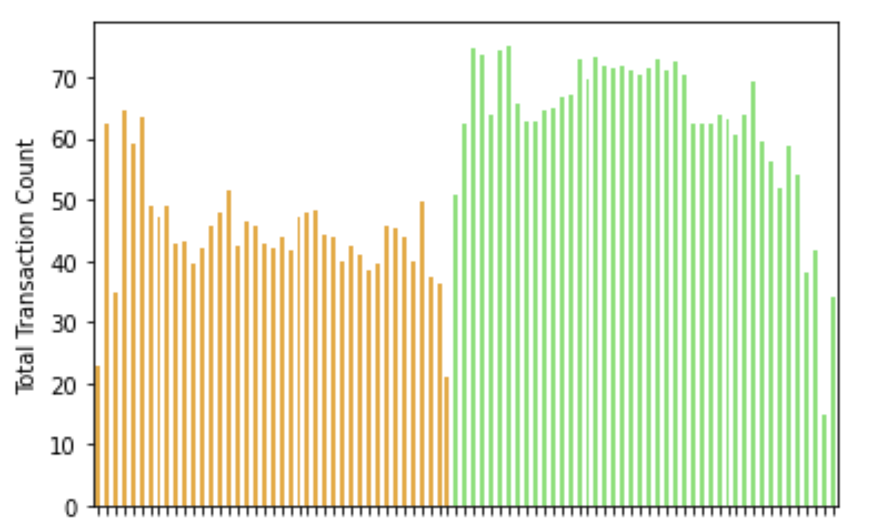
Secondary Exploratory Analysis
Total Transaction Count
Total Transaction Count and Education Level
Total Transaction Count and Age

Slide 27
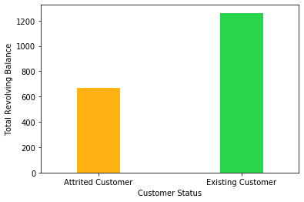
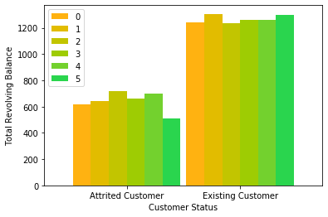
Secondary Exploratory Analysis
Total Revolving Balance
Total Revolving Balance and Attrition Rate
Total Revolving Balance and Dependent Count

Slide 28
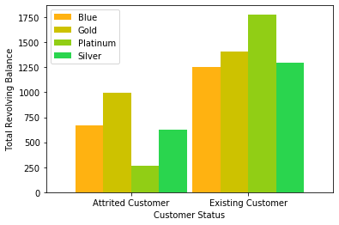
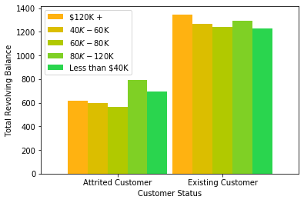
Secondary Exploratory Analysis
Total Revolving Balance
Total Revolving Balance and Card Type
Total Revolving Balance and Income Category

Slide 29

Business Insights
What do we know?
Those who stay have higher utilization
Higher total revolving balances
Higher transaction counts
Higher total change in transaction ratio Q4 - Q1
Higher total relationship count
Double the average utilization ratio
What else do we know?
Regardless of the type of card, number of kids, income category, marital status, gender, age, and months on book, utilization reigns supreme.
What do we do?
Encourage sustained, routine usage
Watch for dips in usage
Implement rewards (cash back) strategies for those who spend a certain amount or transact a certain amount of times each month.
Notes:
what do we know so far? Models tell us
utilization and attrition -- inverse relationship
more utilization -- stay
less utilization -- leave

Slide 30

Potential Issues
Potential External Factor: 36 months
Most of our customers are on the book for 36 months. We assume that this means they have to renew their card then, and many choose not to. This is a change in incentive structure, and could muddy our interpretations.
Data Collection Issue: Stopping
Our dataset is not in time series format, so those who drop the card may have their usage statistics marred by when we cease counting.
If this is the case, all of our utilization metrics are incorrect (too low) for those who churned.
Without clarification from dataset owner, we encourage banks to implement utilization increasing strategies.
Notes:
** we have asked **

Slide 31

Thank You!
Questions?

